Slide 1
APPLICATION OF DECISION TREE LEARNING FOR NETWORK INTRUSION DETECTION SYSTEMS (NIDS)
AI Graduate Project
Darren Cunningham
Moumita Kamal

Slide 2
Outline
Project Description
The Data
Program Description
How it works
Challenges faced
Results
The trees
Performance metrics
Conclusion

Slide 3
Project Description
What is an IDS?
Implement a decision tree learning algorithm to detect malicious network activity
Train using historical network activity
Test using new network activity

Slide 4
Restaurant Data
Attributes
Alternate, Bar, FriSat, Hungry, Patrons, Price, Rain, Reservation, Type, Estimate, WillWait
Datasets
Training set size: 12
No test set

Slide 5
IDS Data
Attributes
duration, protocol_type, count, srv_count, serror_rate, srv_serror_rate, rerror_rate, srv_rerror_rate, same_srv_rate, diff_srv_rate, srv_diff_host_rate, class
Datasets
Training set size: 800
Test set size: 200

Slide 6
How the program works
Input
Attribute file name
Training set file name
Test set file name (optional)
Data extraction
Building the tree
Prediction
Output
The tree
Training and testing performance metrics

Slide 7
Challenges
Understanding how the decision tree algorithm works
Importance
Plurality value
Designing the program
Properly traversing the tree during prediction

Slide 8
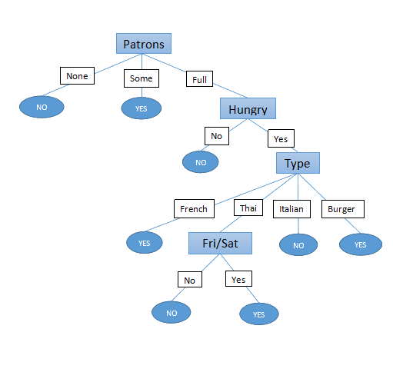
Restaurant Results

Slide 9
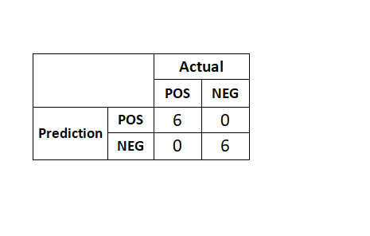
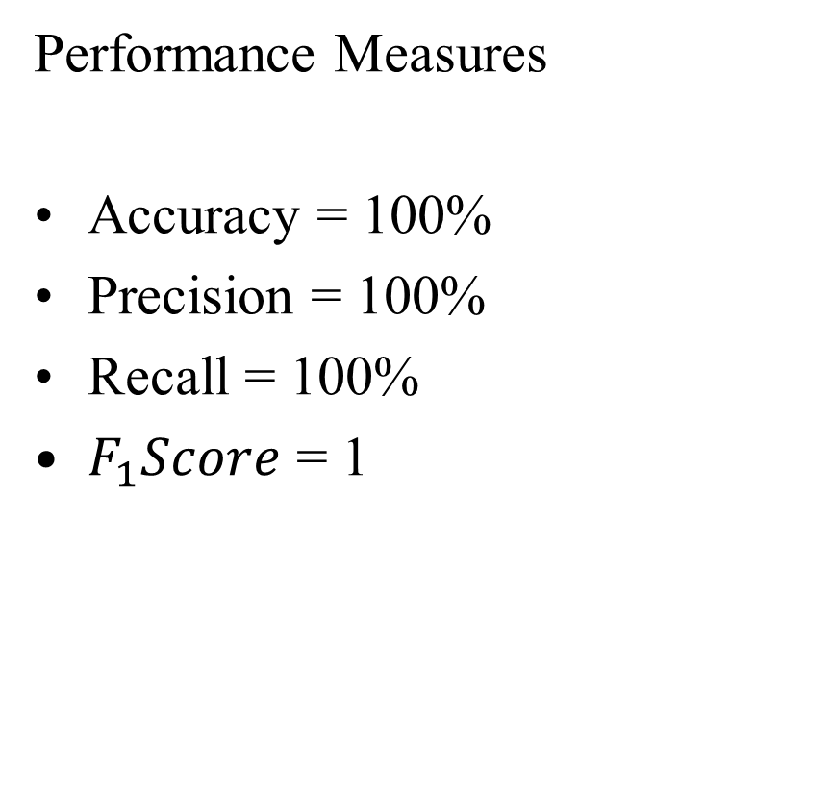
Restaurant Results (contd.)
Performance Measures
Accuracy = 100%
Precision = 100%
Recall = 100%
$F_{1}Score$ = 1
Confusion matrix

Slide 10
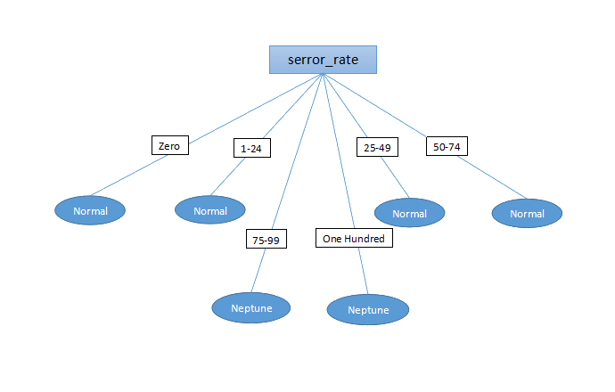
IDS Results

Slide 11
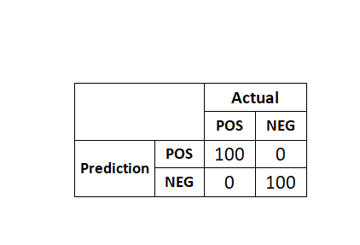
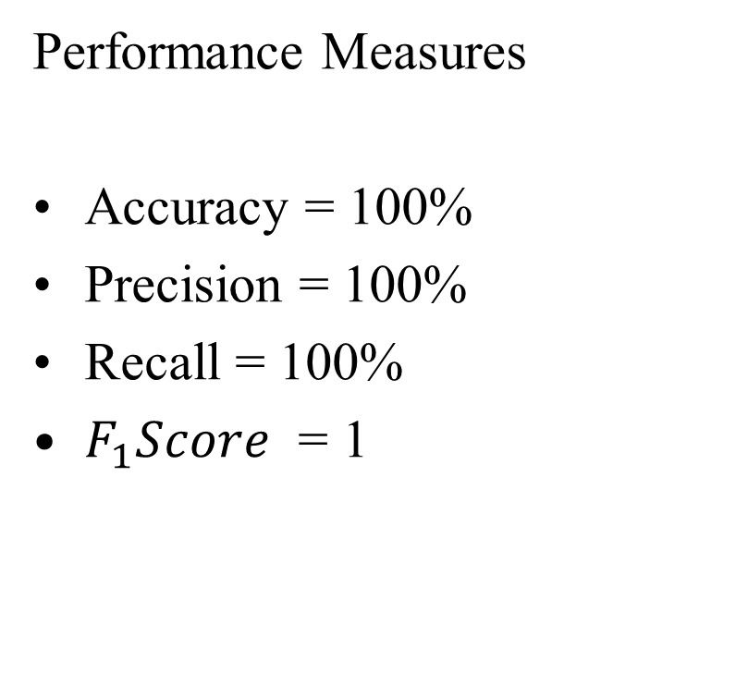
IDS Results (contd.)
Performance Measures
Accuracy = 100%
Precision = 100%
Recall = 100%
$F_{1}Score$ = 1
Confusion matrix

Slide 12
Conclusion
Learned how the decision tree learning algorithm works
Learned how decision trees can be applied to NIDS to detect malicious network activity
Learned how machine learning algorithms can be applied to computer security

Slide 13

Thank you

